Slide 1
Collection Framework
“Collection” and “Collections” both are part of java collection framework, but both serve different purpose.
Collection is a interface of java collection framework. Whereas Collections is an utility class(also termed as helping class).
A Collection is a group of individual objects represented as a single unit.
Java provides Collection Framework which defines several classes and interfaces to represent a group of objects as a single unit. Some types of collections allow duplicate elements, and others do not. Some are ordered and others are unordered.
The Collection interface (java.util.Collection) and Map interface (java.util.Map) are the two main “root” interfaces of Java collection classes.

Slide 2
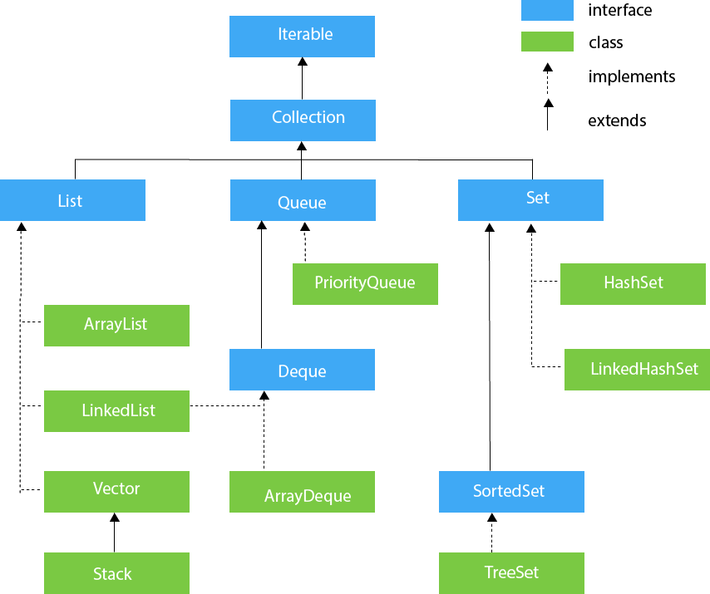

Slide 3
Need for Collection Framework
Before Collection Framework (or before JDK 1.2) was introduced, the standard methods for grouping Java objects (or collections) were Arrays or Vectors or Hashtables. All of these collections had no common interface.

Slide 4
Legacy Classes
Early version of java did not include the Collections framework. It only defined several classes and interfaces that provide methods for storing objects. When Collections framework were added in J2SE 1.2, the original classes were reengineered to support the collection interface. These classes are also known as Legacy classes. All legacy classes and interface were redesign by JDK 5 to support Generics. In general, the legacy classes are supported because there is still some code that uses them.
The following are the legacy classes defined by java.util package
1) Dictionary
2) HashTable
3) Properties
4) Stack
5) Vector
There is only one legacy interface called Enumeration
NOTE: All the legacy classes are synchronized

Slide 5
JAVA LIST INTERFACE
List Interface is the sub interface of Collection.
A List is an ordered Collection (sometimes called a sequence).
Lists may contain duplicate elements.

Slide 6
JAVA ARRAYLIST CLASS
Java ArrayList class uses a dynamic array for storing the elements.
Java ArrayList class can contain duplicate elements,including null.
Java ArrayList class maintains insertion order.
Java ArrayList class is non synchronized.
Java ArrayList allows random access because array works at the index basis.
In Java ArrayList class, manipulation is slow because a lot of shifting needs to occur if any element is removed from the array list.

Slide 7
ARRAY VS ARRAYLIST IN JAVA
Array is a fixed length data structure whereas ArrayList is a variable length Collection class.
We cannot change length of array once created in Java but ArrayList can be changed.
We cannot store primitives in ArrayList, it can only store objects. But array can contain both primitives and objects in Java.
Since Java 5, primitives are automatically converted in objects which is known as auto-boxing.

Slide 8
JAVA LINKEDLIST CLASS
Java LinkedList class uses a doubly linked list to store the elements. It provides a linked-list data structure.
Java LinkedList class can contain duplicate elements (including null).
Java LinkedList class maintains insertion order.
Java LinkedList class is non synchronized.
In Java LinkedList class, manipulation is fast because no shifting needs to occur.
Java LinkedList class can be used as a list, or queue.

Slide 9
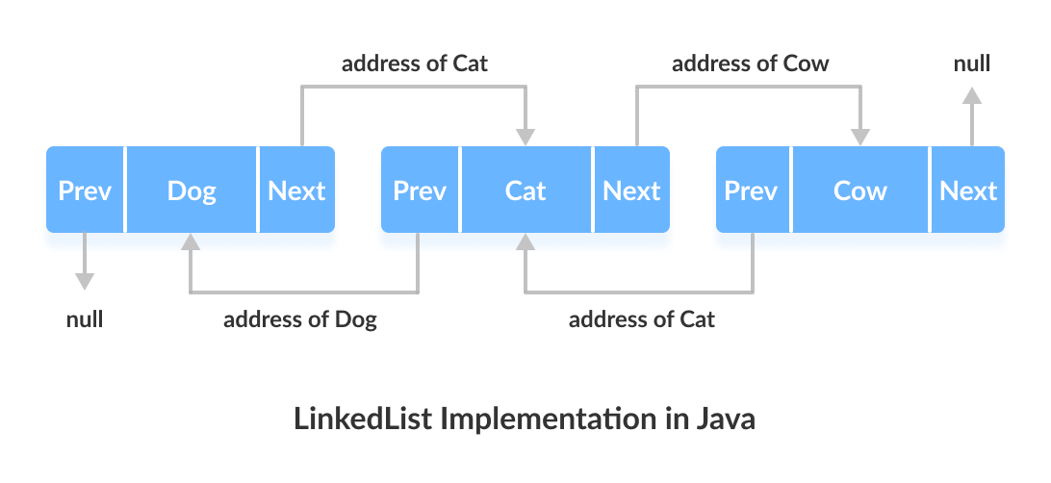

Slide 10
ArrayList vs LinkedList
1) ArrayList internally uses a dynamic array to store the elements.
LinkedList internally uses a doubly linked list to store the elements.
2) Manipulation with ArrayList is slow because it internally uses an array. If any element is removed from the array, all the bits are shifted in memory.
Manipulation with LinkedList is faster than ArrayList because it uses a doubly linked list, so no bit shifting is required in memory.
3) An ArrayList class can act as a list only because it implements List only.
LinkedList class can act as a list and queue both because it implements List and Deque interfaces.
4) ArrayList is better for storing and accessing data.
LinkedList is better for manipulating data.

Slide 11
DIFFERENCE BETWEEN ARRAYLIST AND VECTOR
ArrayList and Vector both implements List interface and maintains insertion order. Vector is similar to ArrayList which represents a dynamic array.
There are some differences between Vector and ArrayList.
Vector is a legacy class whereas ArrayList is not a legacy class,It is introduced in JDK 1.2.
Vector is synchronized and it contains many legacy methods that are not part of the Collections Framework whereas ArrayList is non synchronized.

Slide 12
With the release of JDK 5, Vector also implements Iterable. This means that Vector is fully compatible with collections, and a Vector can have its contents iterated by the for-each loop.
ArrayList is fast because it is non-synchronized whereas Vector is slow because it is synchronized.
ArrayList uses the Iteratorinterface to traverse the elements whereas Vector can use the Iterator interface or Enumeration interface to traverse the elements.

Slide 13
STACK CLASS
Stack class extends Vector.
It follows last-in, first-out principle for the stack elements.
If you want to put an object on the top of the stack, call push() method.
If you want to remove and return the top element, call pop() method.
An EmptyStackException is thrown if you call pop() method when the invoking stack is empty.
You can use peek() method to return, but not remove, the top object.
The empty() method returns true if nothing is on the stack.
The search() method determines whether an object exists on the stack and returns the number of pops that are required to bring it to the top of the stack.

Slide 14
Set Interface
Set -a collection that cannot contain duplicate elements.
Note : A list can contain duplicate elements whereas Set contains unique elements only.
Set interface includes :
HashSet Class
LinkedHashSet Class
TreeSet Class

Slide 15
HashSet class
HashSet stores the elements by using a mechanism called hashing(Hashing in data structure is an efficient technique to perform the search).
HashSet contains unique elements only.
HashSet allows null value.
HashSet class is non synchronized.
HashSet doesn't maintain the insertion order. Here, elements are inserted on the basis of their hashcode.

Slide 16
LinkedHashSet class
Java LinkedHashSet class contains unique elements only like HashSet.
Java LinkedHashSet class provides all optional set operation and permits null elements.
Java LinkedHashSet class is non synchronized.
Java LinkedHashSet class maintains insertion order.

Slide 17
TreeSet class
Java TreeSet class contains unique elements only like HashSet.
Java TreeSet class doesn't allow null element.
Java TreeSet class is non synchronized.
Java TreeSet class maintains ascending order.

Slide 18
JAVA QUEUE INTERFACE
Java Queue interface orders the element in FIFO(First In First Out) manner. In FIFO, first element is removed first and last element is removed at last.
Some Methods :
boolean offer(object) : It is used to insert the specified element into this queue.
Object remove() : It is used to retrieves and removes the head of this queue.

Slide 19
3. Object poll() : It is used to retrieves and removes the head of this queue, or returns null if this queue is empty.
4. Object element() : It is used to retrieves, but does not remove, the head of this queue.
5. Object peek() : It is used to retrieves, but does not remove, the head of this queue, or returns null if this queue is empty.

Slide 20
JAVA MAP INTERFACE
A map contains values on the basis of key, i.e. key and value pair. Each key and value pair is known as an entry. A Map contains unique keys.
A Map is useful if you have to search, update or delete elements on the basis of a key.
A Map doesn't allow duplicate keys, but you can have duplicate values. HashMap and LinkedHashMap allow null key and values, but TreeMap doesn't allow any null key.
A Map can't be traversed, so you need to convert it into Set using keySet() or entrySet() method.

Slide 21
HashMap Class
Java HashMap class contains values based on the key.
Java HashMap class contains only unique keys.
Java HashMap class may have one null key and multiple null values.
Java HashMap class is non synchronized.
Java HashMap class maintains no order.

Slide 22
LinkedHashMap class
Java LinkedHashMap contains values based on the key.
Java LinkedHashMap contains unique elements.
Java LinkedHashMap may have one null key and multiple null values.
Java LinkedHashMap is non synchronized.
Java LinkedHashMap maintains insertion order.

Slide 23
TreeMap class
Java TreeMap contains values based on the key.
Java TreeMap contains only unique elements.
Java TreeMap cannot have a null key but can have multiple null values.
Java TreeMap is non synchronized.
Java TreeMap maintains ascending order.

